Slide 1

SYSTEM ARCHITECTURE
File360
Enterprise File Tracking Application
Process flow, module breakdown, and technical lifecycle overview.

Slide 2

Foundational Data Hierarchy
Master data prerequisites for file creation.
Organizational Flow
Company
Branch
Department
Employee
User Account
Classification Flow
Soft Deletions: Historical relational links remain intact even after active records are removed.
Category
Sub Category

Slide 3



Core System Modules
Dashboard
Masters
Transactions
Role-scoped summary widgets.
Bulk CSV import/export data management.
The operational core lifecycle.
Report
Settings
Full movement audit trail and PDF exports.
Permission matrix and application configuration.

Slide 4
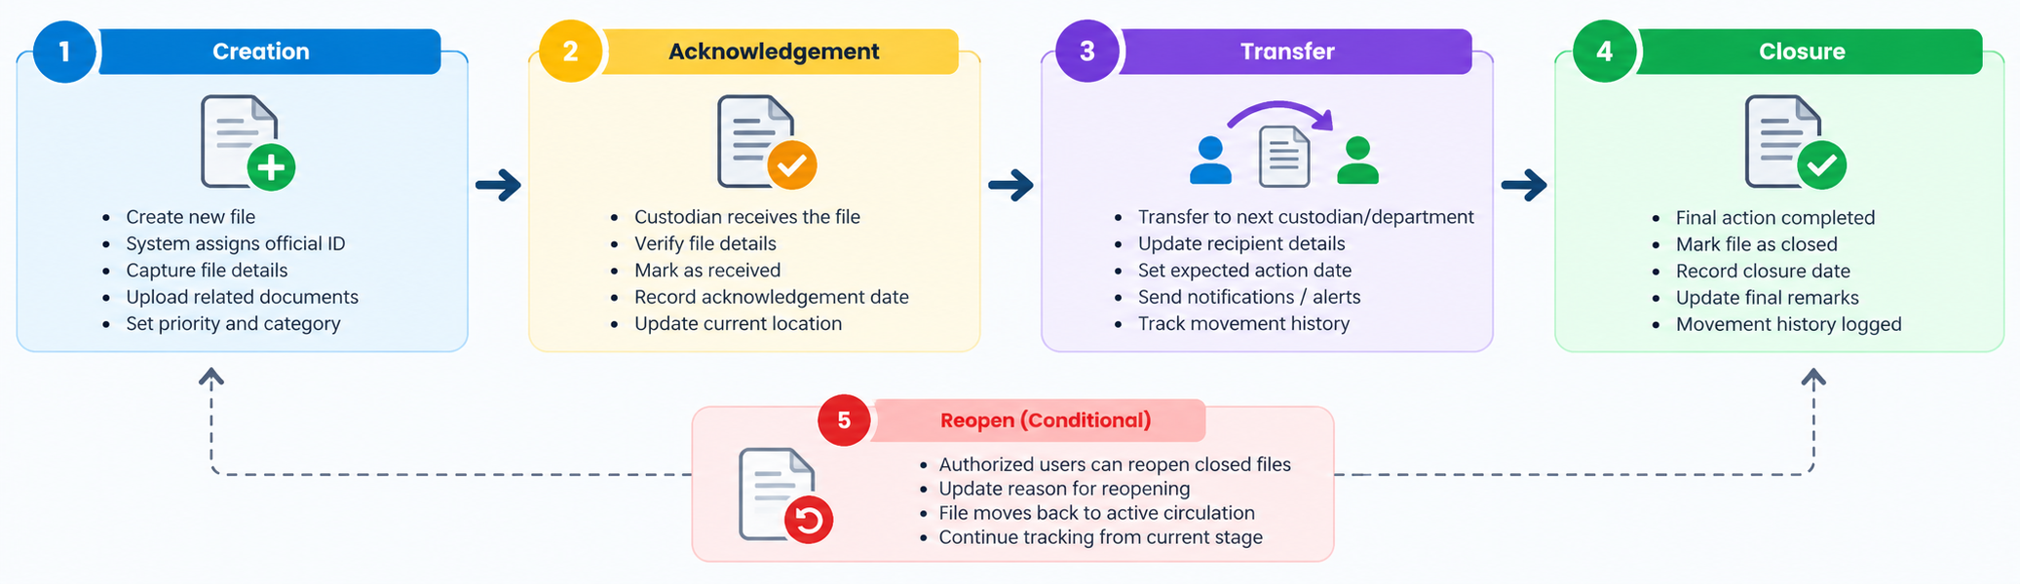






File Lifecycle Workflow
Creation
Acknowledgement
Transfer
Closure
System assigns official ID.
Custodian marks as received.
Custody routing with alerts.
Final completed movement logged.
Reopen (Conditional)
Authorized users can restore closed files to active circulation.

Slide 5
System State Management
File Status
Movement Status
Open
Active and in circulation.
Not Received
Pending recipient acknowledgement.
Work complete; currently inactive.
Received
Current holder has custody.
Closed
In Progress
Actively being worked on.
Transferred
Custody is moving.
Completed
Logged alongside file closure.

Slide 6


Role-Based Access Control
Administrator
Standard User
Organization-wide visibility.
Identity-bound access scope.
Full master data control.
Action limited to assigned files.
Permission matrix configuration.
Unregistered employees excluded.

Slide 7




Design Principles & Reliability
Single-Custodian Model
Identity Uniqueness
Strict holder-only transfer rights.
Enforced RFID and file ID uniqueness.
Immutable Audit
Atomic Transactions
Append-only history entries.
Fail-safe file creation sequences.

Slide 8
Thanks You
THANK Y
For your wathcing

